Slide 1





Teacher Workshop 2024
Western Lake Superior Sanitary District
Erik Johnson, erik.johnson@wlssd.com

Slide 2
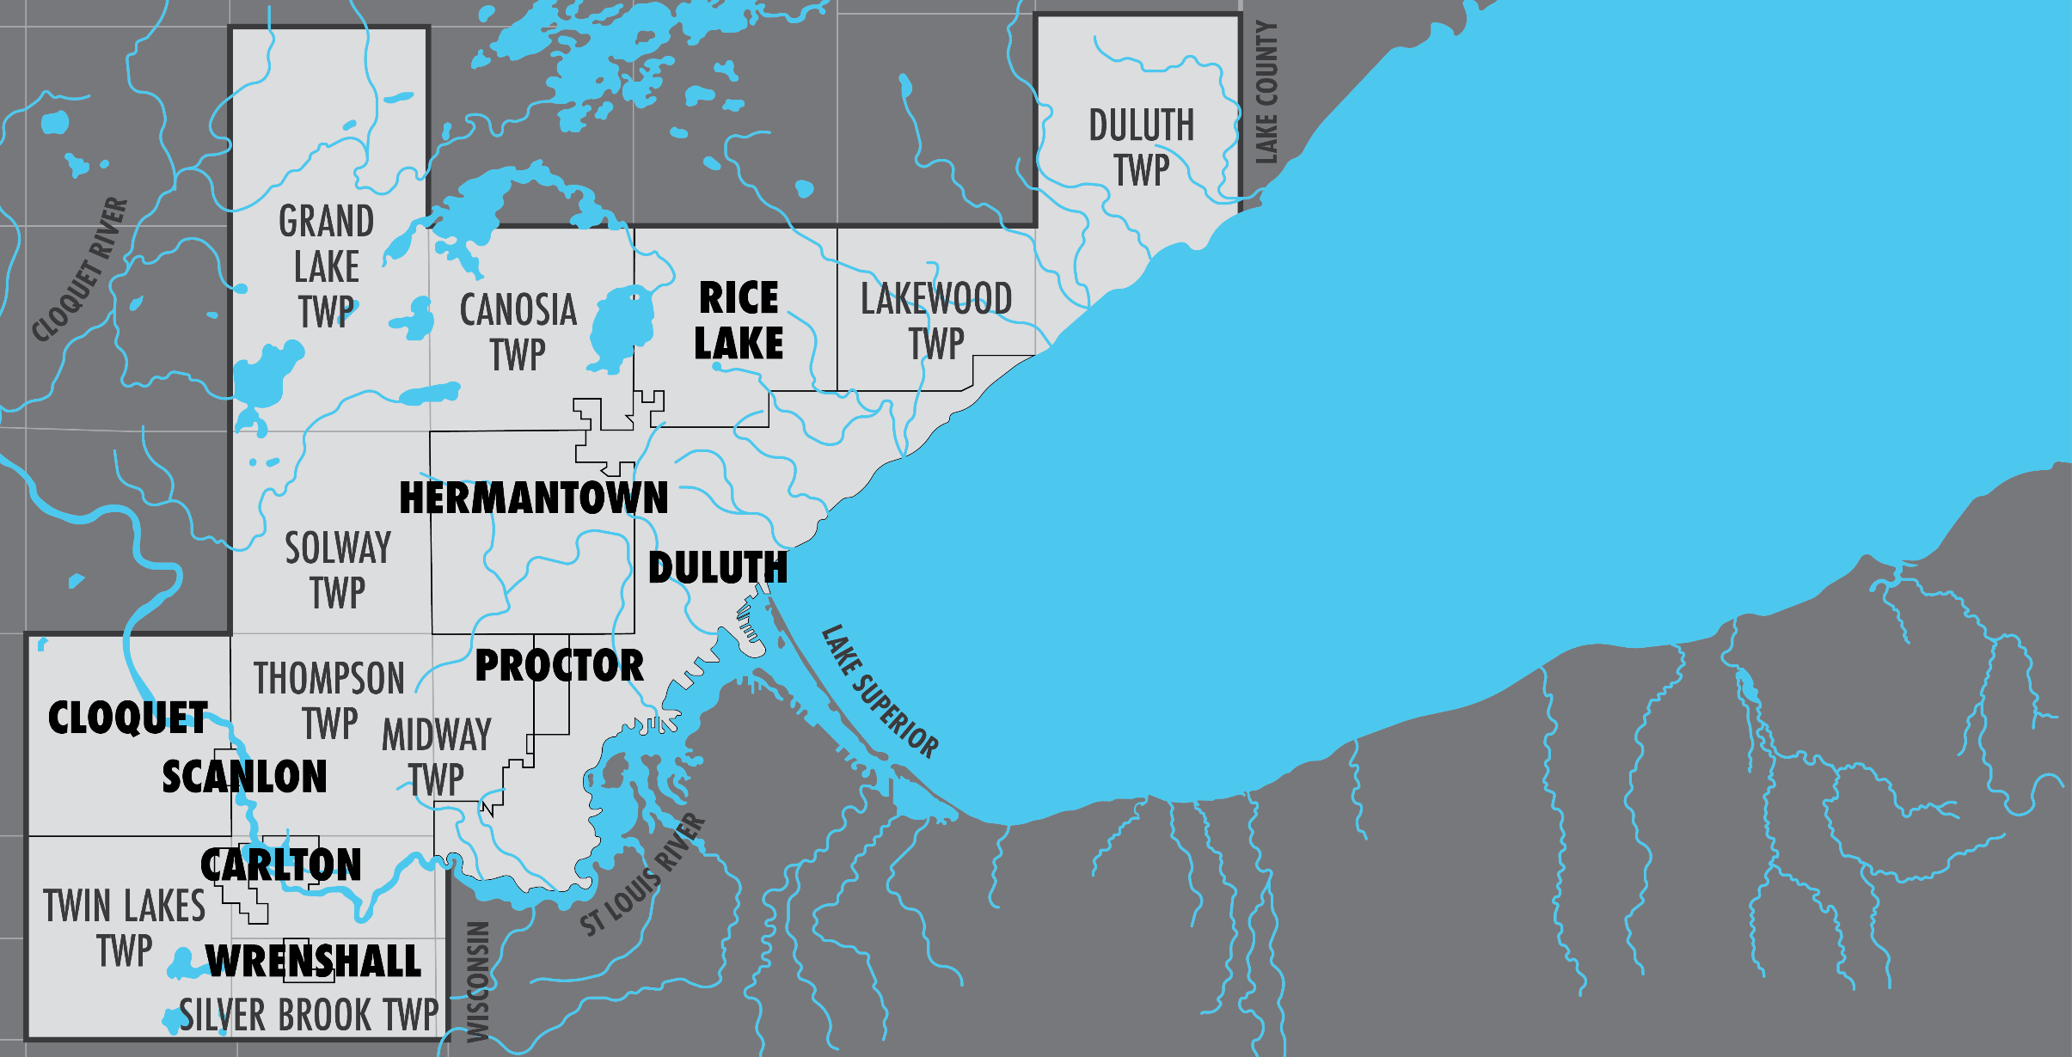
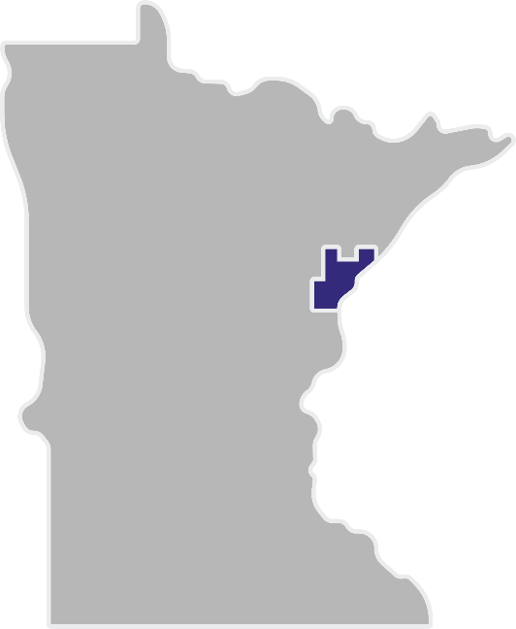
Welcome to
WLSSD

Slide 3
WLSSD Teacher Workshop Schedule
8:30 – Arrive – Welcome, intros, overview of day, goal
8:45-10:15 – Wastewater Treatment Plant Tour (Ryan and Emma)
10:15-10:30 – Break
10:30-11:45 – WWTP lessons/activities (Show/share)
11:45-12:05 - Career pathways for students (Joel Jasmer, MRWA)
12:10-1:00 – Lunch (w/ other employees joining to speak informally)
1:00-2:30 – Courtland Solid Waste Tour (Emma and Dori)
2:30-3:30 – Paperwork, work on curriculum, collaborate

Slide 4
Goals of day
Become more familiar with wastewater treatment process and WLSSD
Explore activities for the classroom
Learn about careers you can highlight for students
Brainstorm ways to incorporate wastewater treatment into your classroom

Slide 5
WLSSD Teacher Workshop Schedule
8:30 – Arrive – Welcome, intros, overview of day, goal
8:45-10:15 – WWTP Tour (Ryan and Emma)
10:15-10:30 – Break
10:30-11:45 – WWTP lessons/activities (Show/share)
11:45-12:05 - Career pathways for students (Joel Jasmer, MRWA)
12:10-1:00 – Lunch (w/ other employees joining to speak informally)
1:00-2:30 – Courtland Solid Waste Tour (Emma and Dori)
2:30-3:30 – Paperwork, work on curriculum, collaborate

Slide 6
WWTP/WRRF Tour
Any big takeaways? Surprises?

Slide 7
Teacher Workshop July 11th
Activities: Highlight a few, then provide time to explore
Large Wastewater Model
Interactive Virtual Tour
Microscopes – Microbe Bingo
Engineer a mini-wastewater treatment plant
Build-a-bug
Wastewater
WASTEWATER

Slide 8
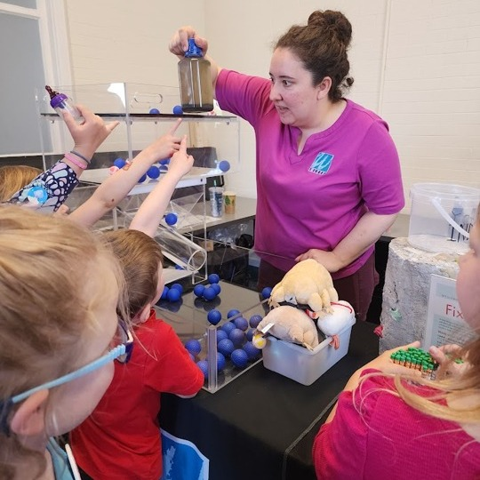
Large Model
(River Quest area 6th graders)

Slide 9
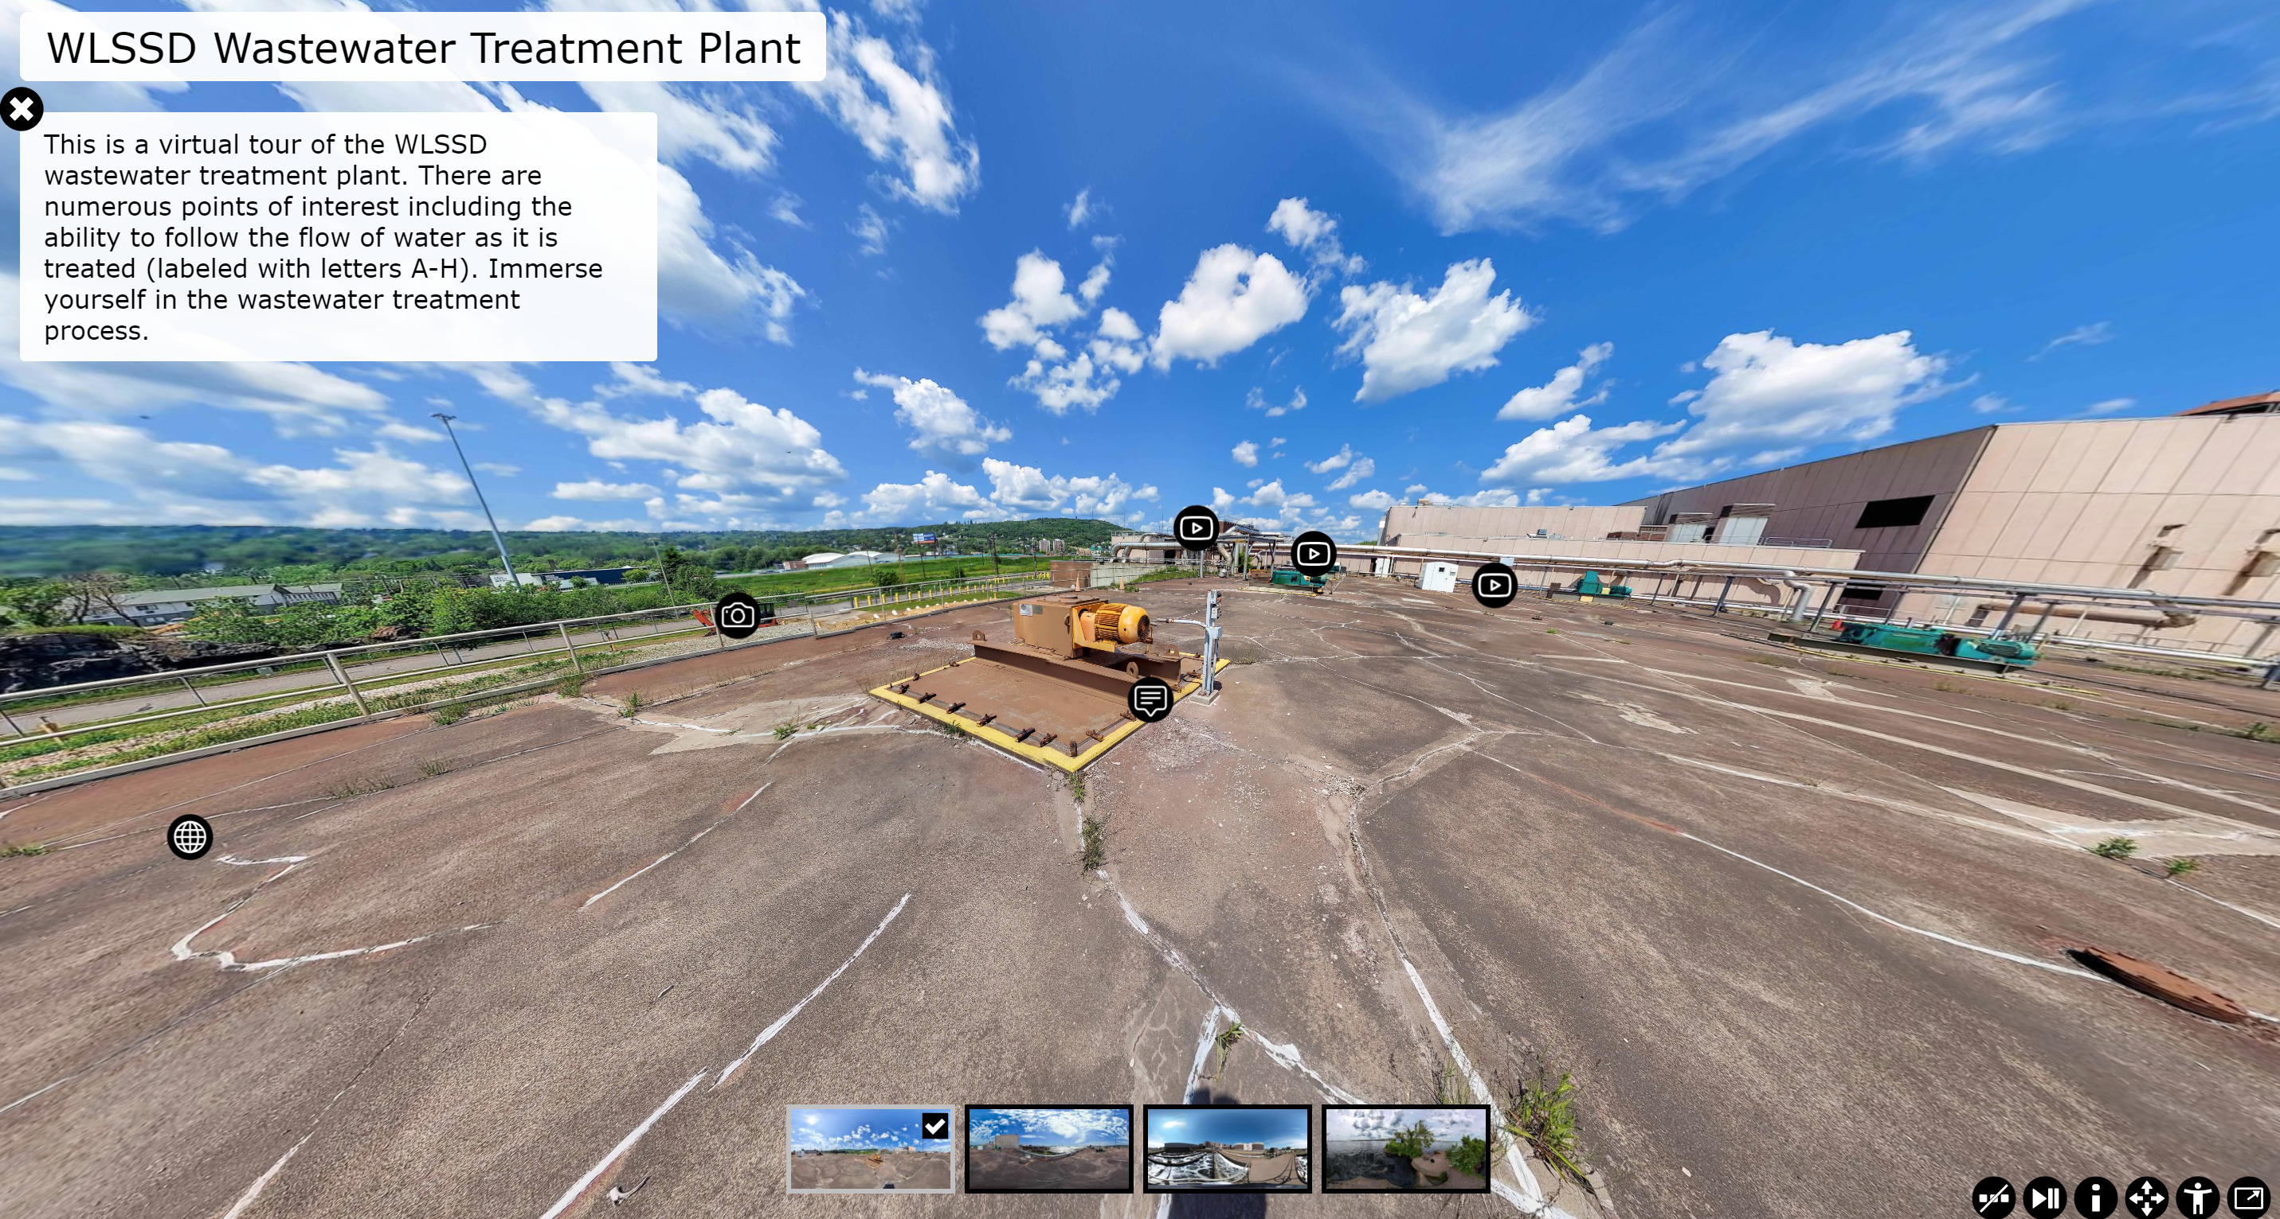
Interactive Virtual Tour
https://p.tourit.etx.asu.edu/v1fshqa2/zei0ovd8bo4wkj5/index.html

Slide 10
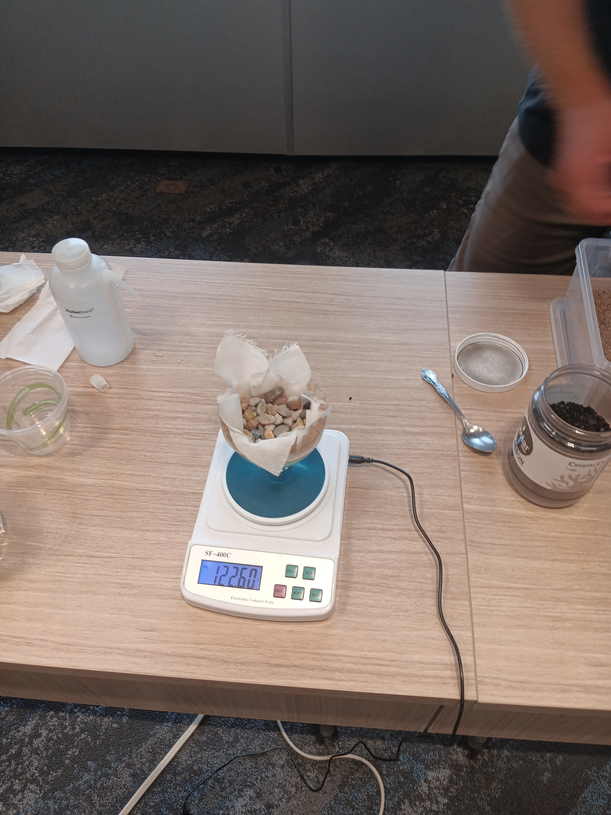
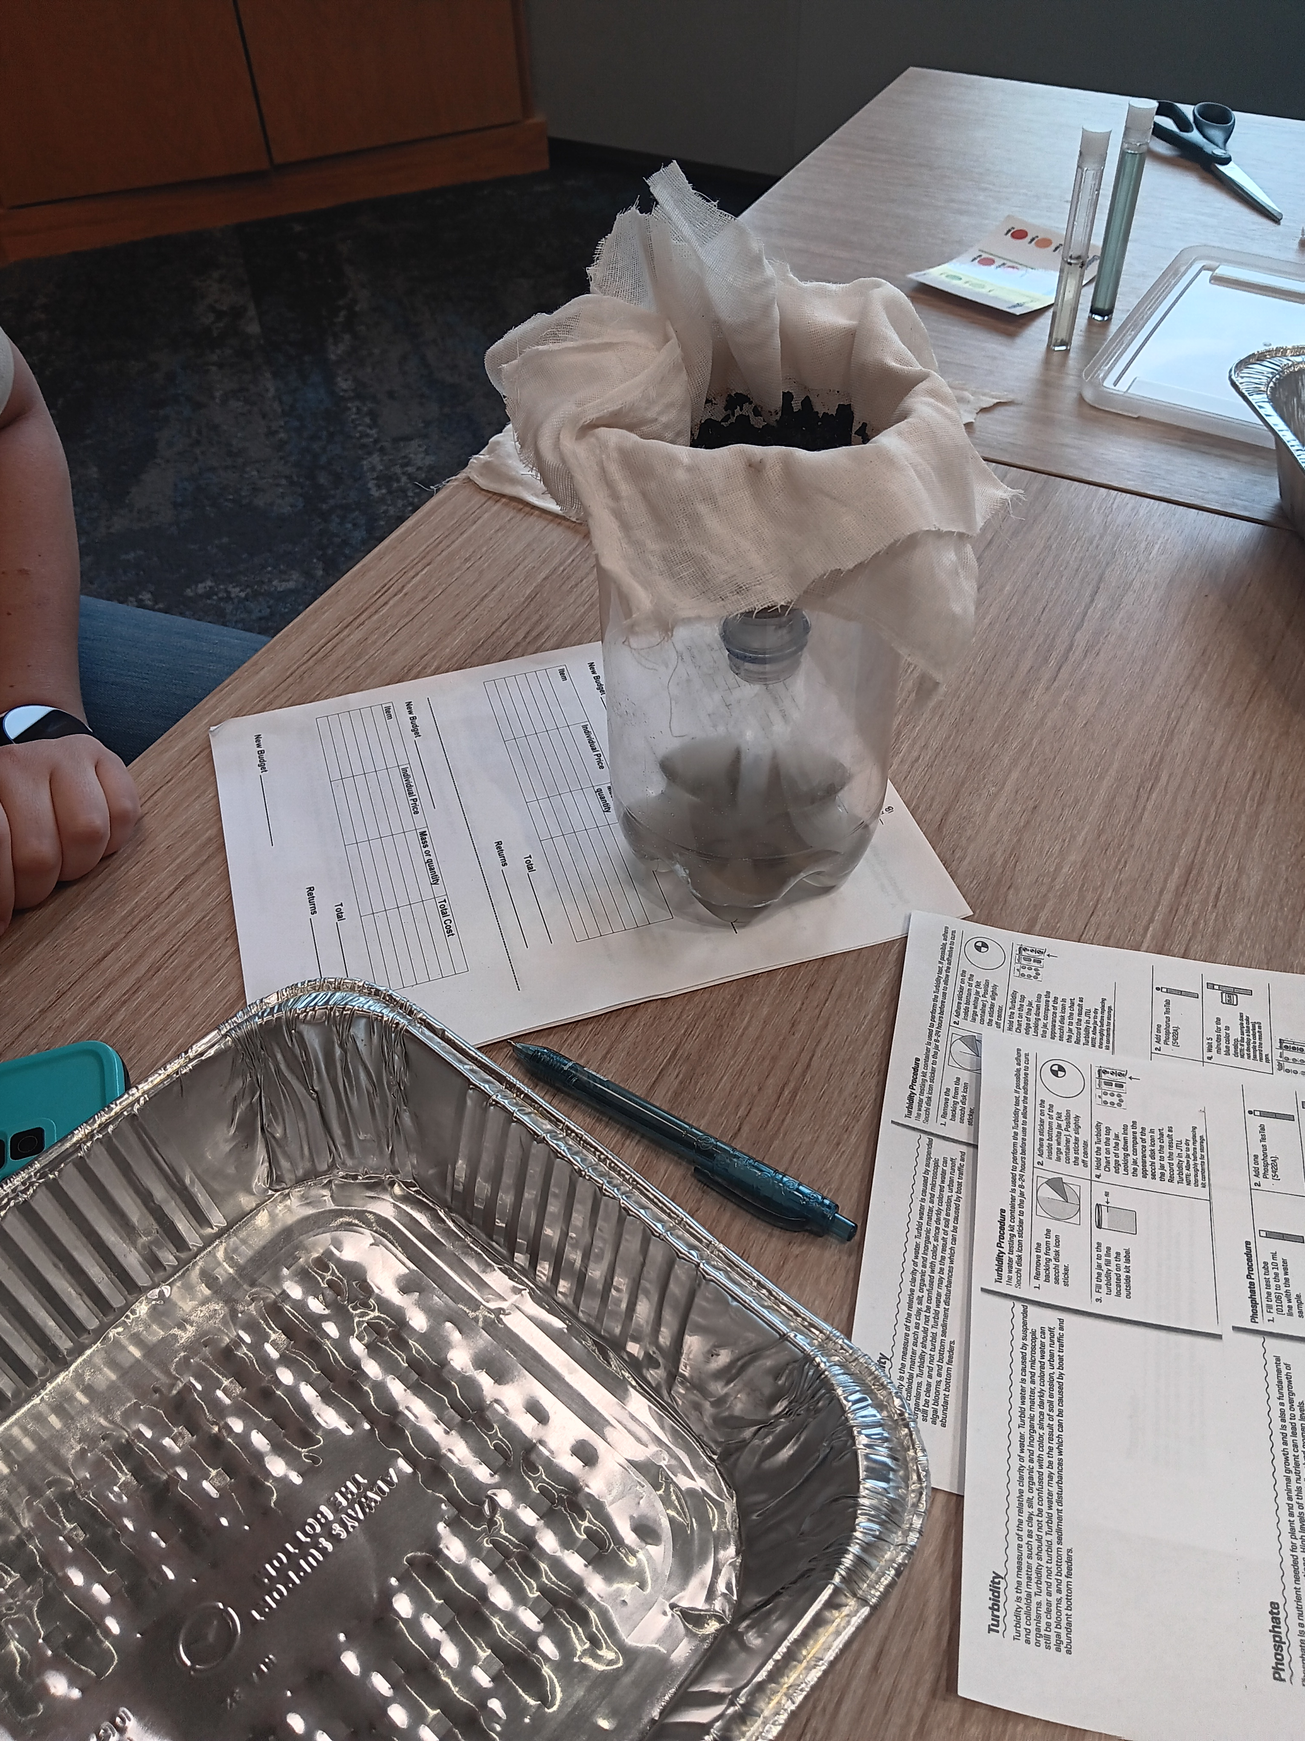
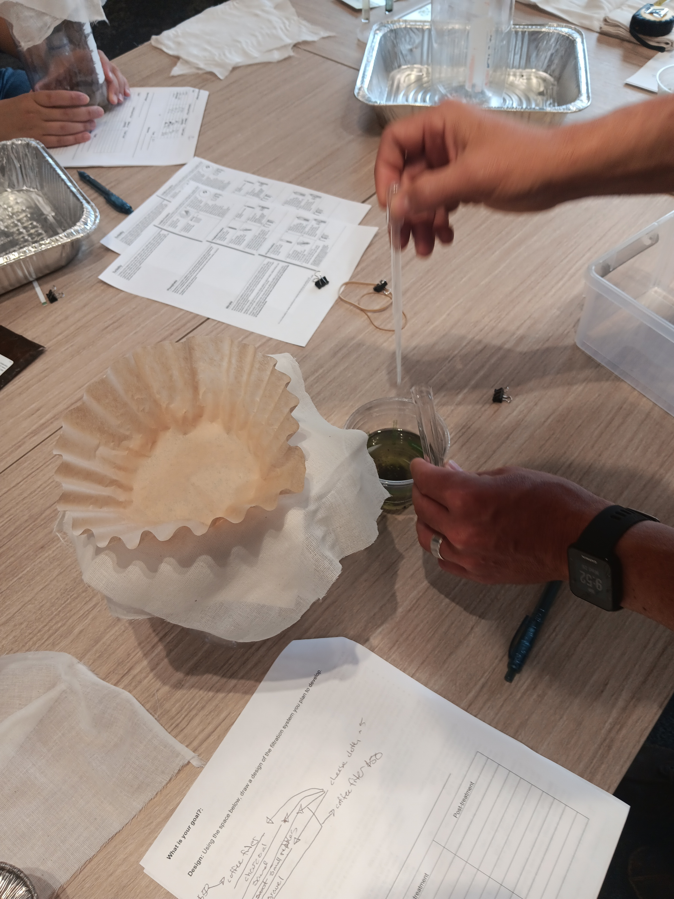
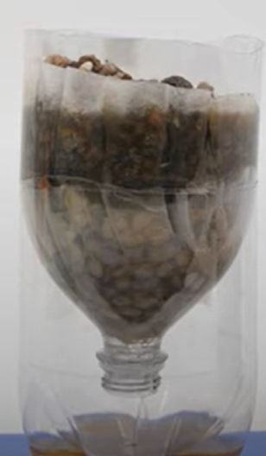
Engineer a mini Wastewater treatment Plant
Notes:
Might require 2 days – planning first day, and get to it/clean-up the second day?

Slide 11
Design and build the project within the cost constraints
Materials available:
Fine-grain sand
Large gravel
Small pebbles
Activated charcoal
Coffee filters
Cotton mesh
Yeast
Additional 2-liter bottle
Wastewater
WASTEWATER

Slide 12
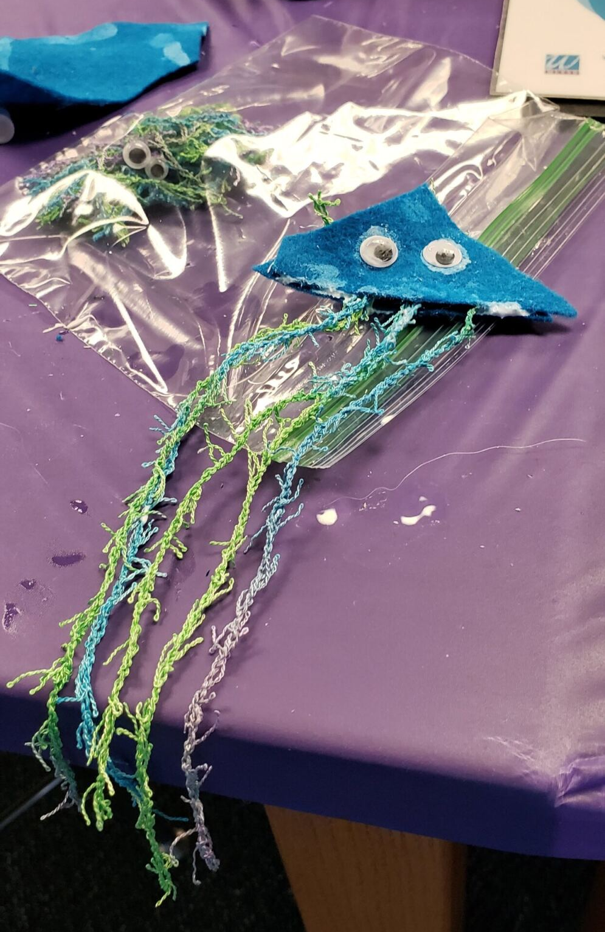
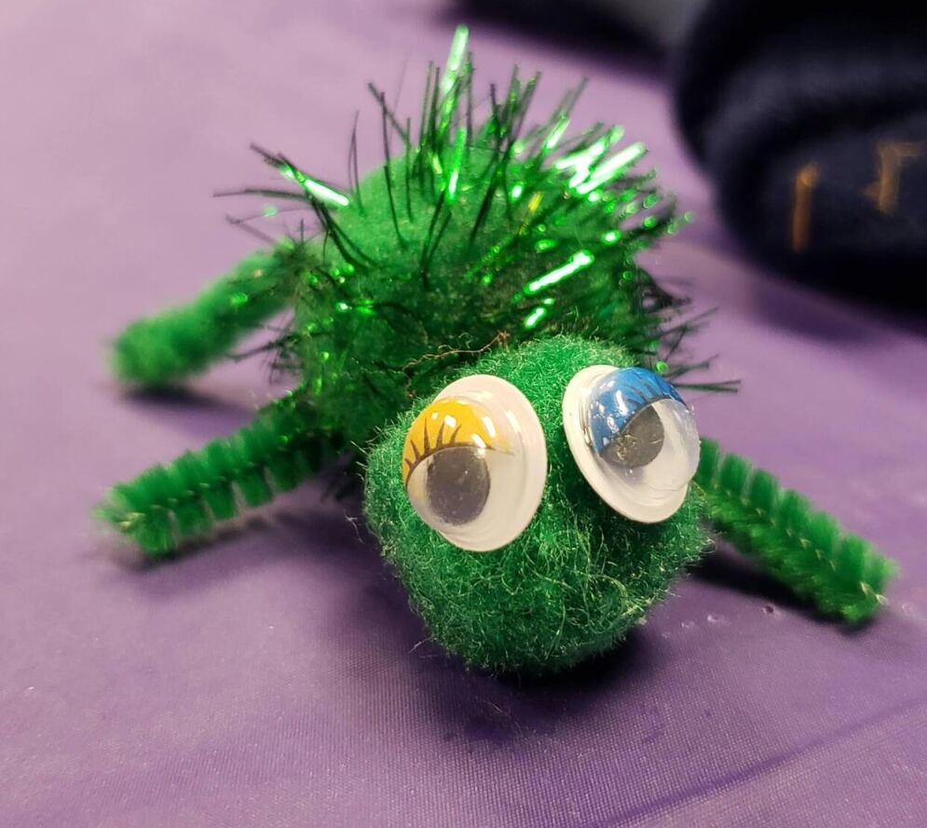
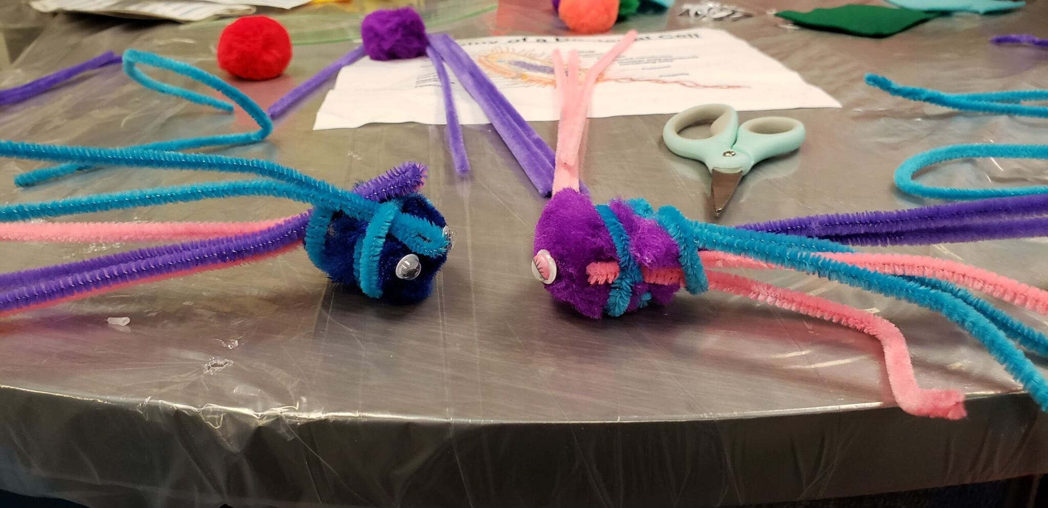
Build-a-bug

Slide 13
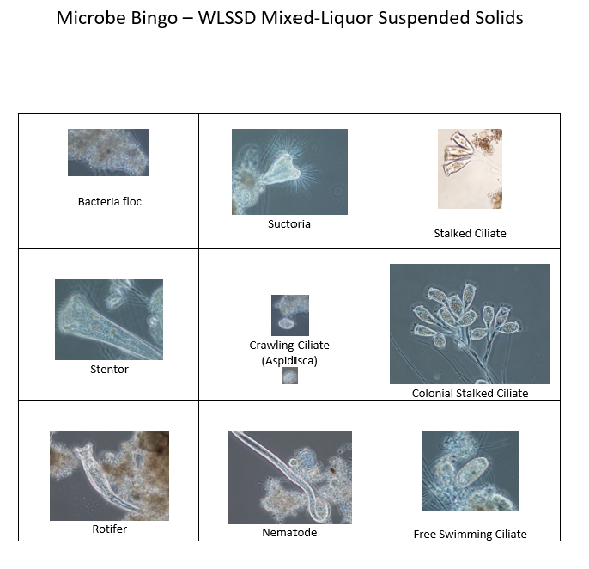
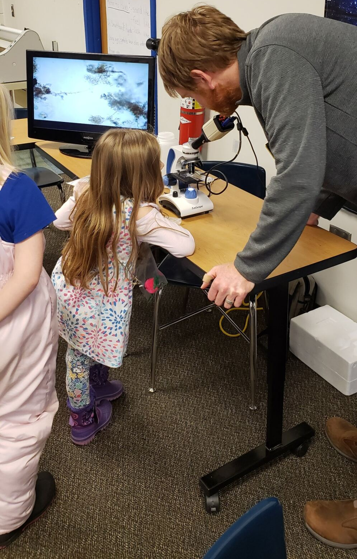
Microbe Bingo
Standards?
Notes:
How do cells fit in with standards?

Slide 14
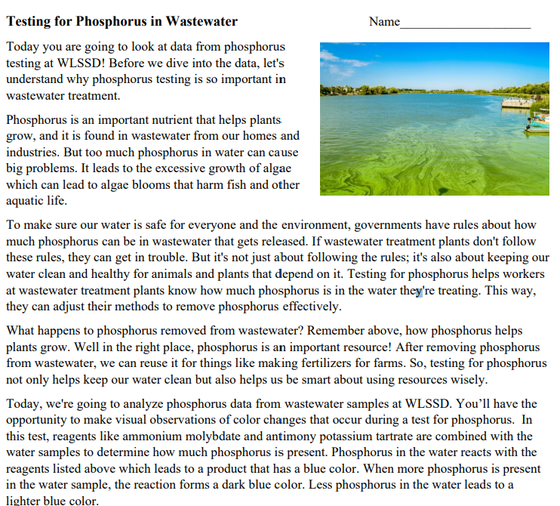
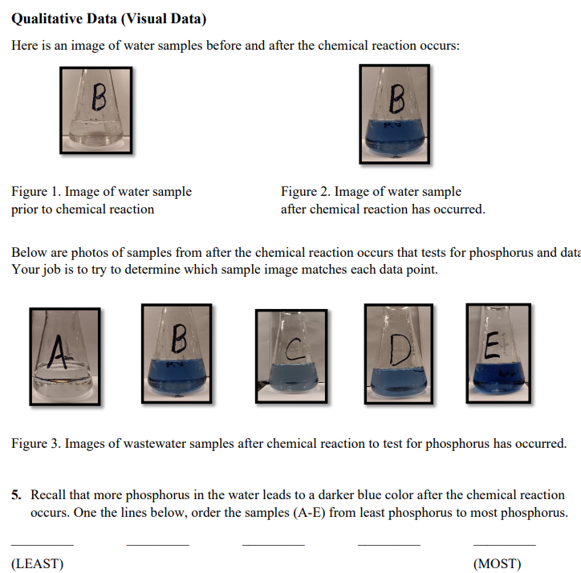
Phosphorus Data Nugget

Slide 15
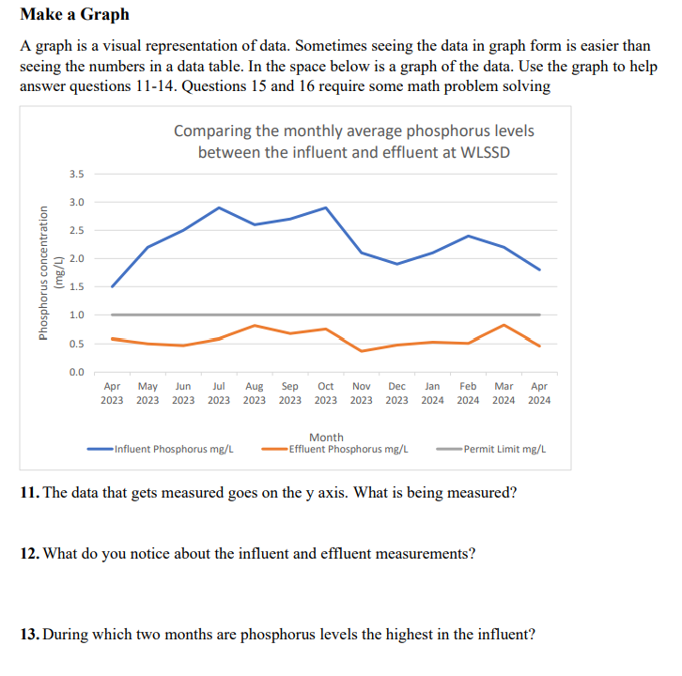
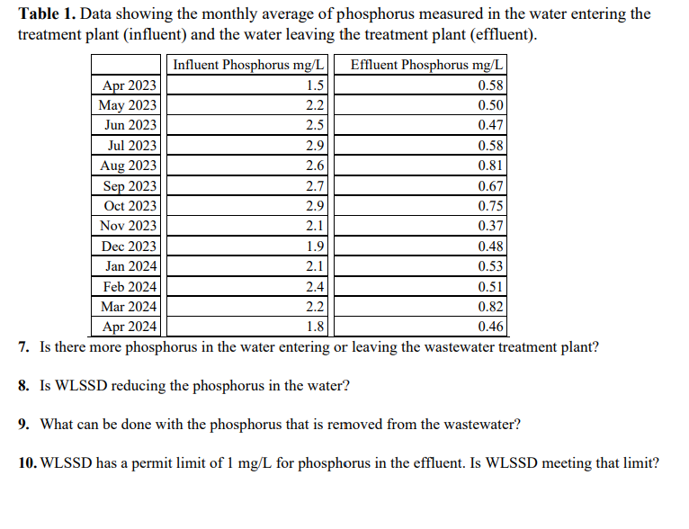
Phosphorus Data Nugget

Slide 16
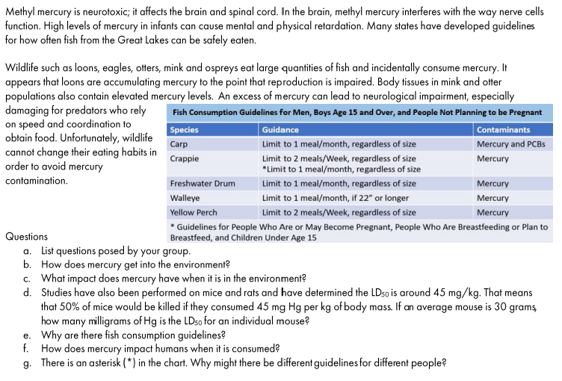
Mercury Case Study

Slide 17
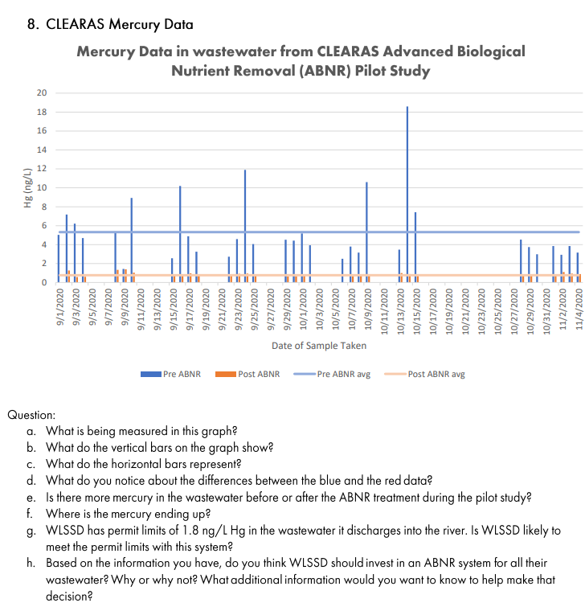
Mercury Case Study

Slide 18
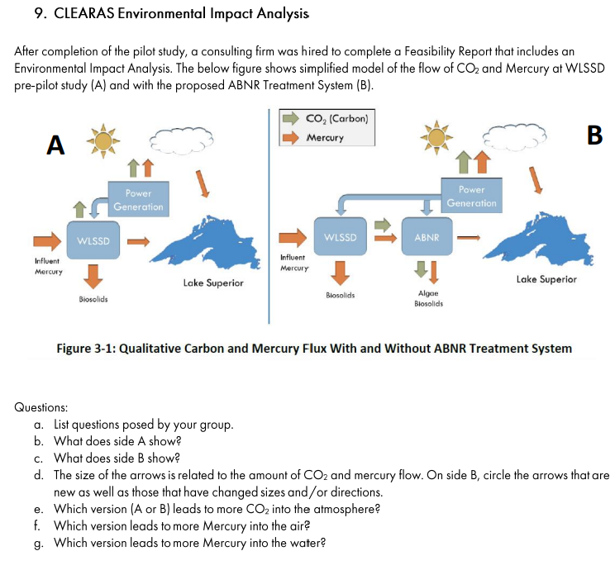
Mercury Case Study

Slide 19
Career Pathways
Wastewater
WASTEWATER

Slide 20
Afternoon
1:00-2:30 – Courtland Solid Waste Tour (Emma and Dori)
2:30-3:30 – Paperwork, work on curriculum, collaborate
  Grant paperwork
  Feedback of day
  Share how you can envision incorporating WW into a lesson

Slide 21
What would be most helpful for you? (Additional comments)
Activities?
Based on MN Standards? Or just engaging topics?
Funding for busses?
Wastewater
WASTEWATER

Slide 22
Share with rest of us what you are leaning towards doing to incorporate Wastewater Treatment?
Wastewater
WASTEWATER

Slide 24
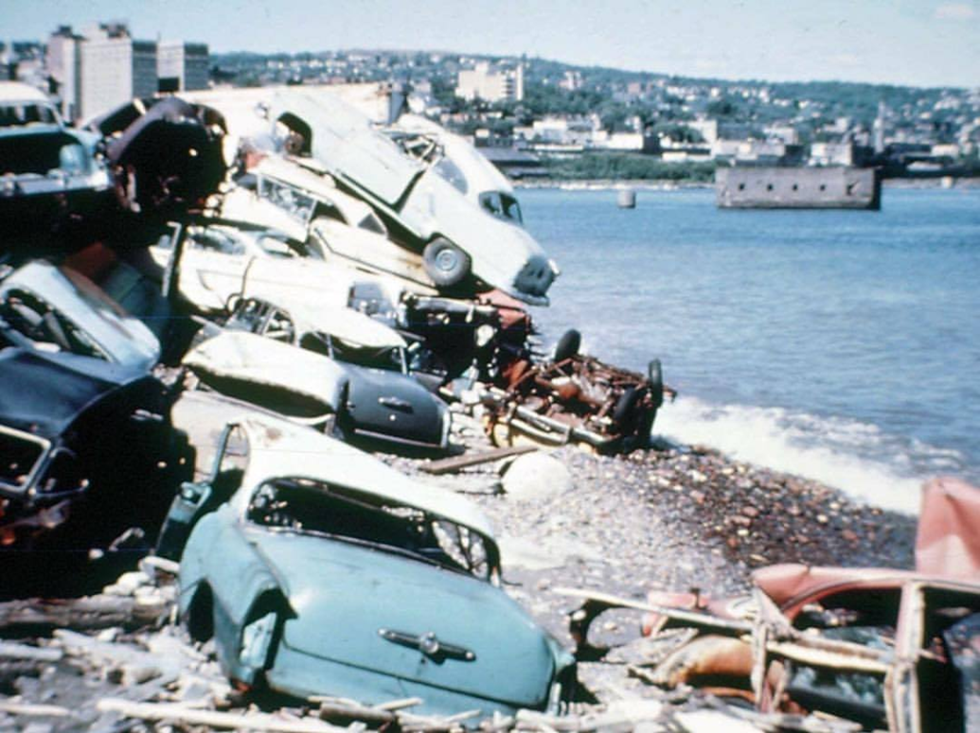
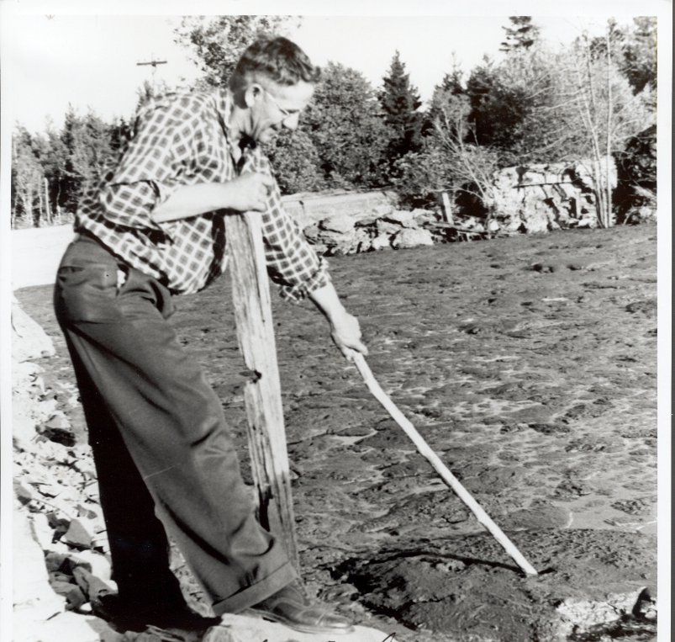
Lyle Brand of the United Northern Sportsmen examining sludge in the St. Louis River.

Slide 25
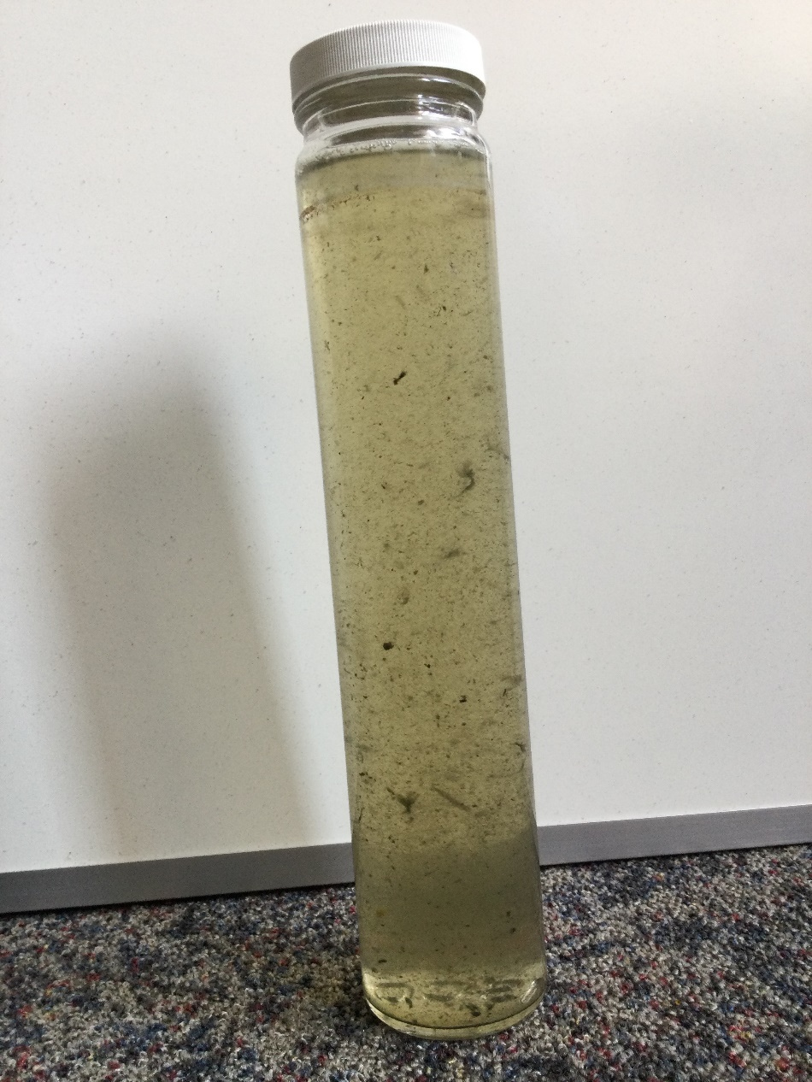
Wastewater Influent

Slide 26
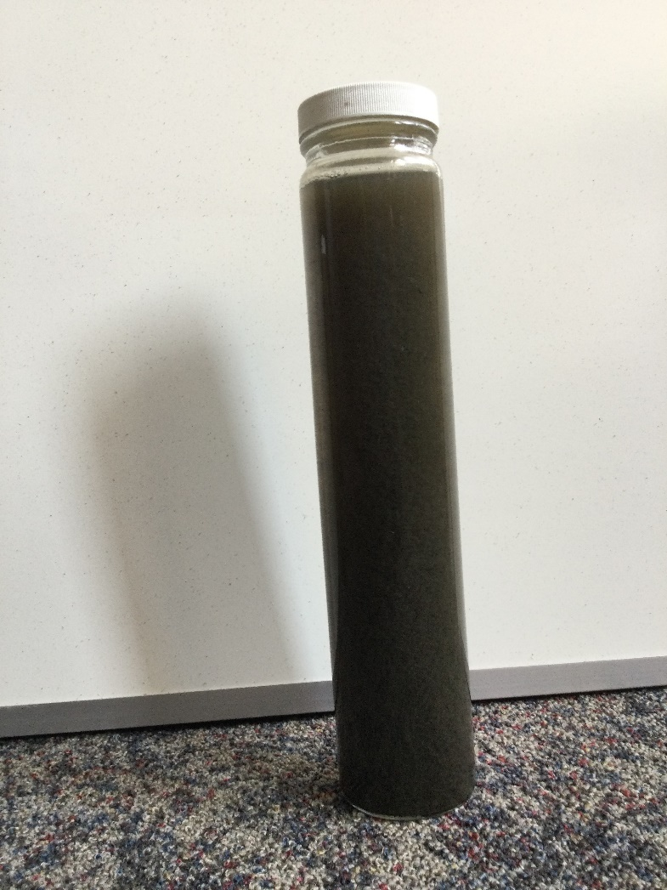
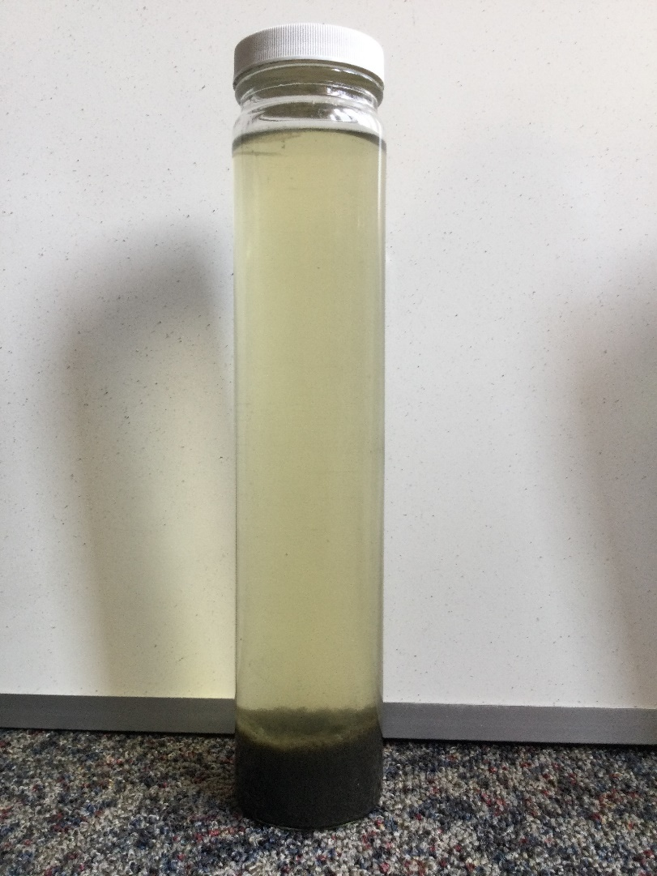
Sample from ‘reactor deck’ filled with bacteria
Sample from ‘reactor deck’ filled with bacteria, allowed to settle
Mimics the clarifier

